Slide 1
Welcome to
Our Sunday School
We’ll start at 9:07
visit OurSundaySchool.com for more about our class

Slide 2
Philemon, week 5 (pages 37-41)

Slide 3
Homework Review: Praying and Thanking God for OSS Members
Mila Archer | David Barber | Linda Decker | Jessica Miller
Tim Archer | Grace Barber | Dawn Fleming | Bruce Morgan
Chris Arnold | Margy Barber | Jim Fleming | Thesa Morgan
Kimberly Arnold | Josh Blair | Julie Fleming | Jessica Norris
Shanda Arter | Leslie Blair | Julia Gregg | Rachel Samsel
Zeke Arter | Gracie Coffey | Mitch Johnson | Darla Skinner
Jennifer Ayers | Jeff Coffey | Sherry Johnson | Doug Skinner
Matt Ayers | Lori Coffey | Sean McGarvey | Sondra Tweed
Bethany Barber | Bryan Decker | Trisha McGarvey

Slide 4
Speak, O Lord

Slide 5
Philemon, week 5 (pages 37-41)

Slide 6
Philemon 1:8-9a
For this reason, although I have great boldness in Christ to command you to do what is right, I appeal to you, instead, on the basis of love.

Slide 7
Philemon, week 5 (pages 37-41)

Slide 8
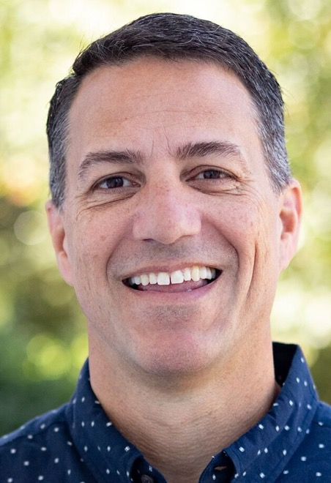
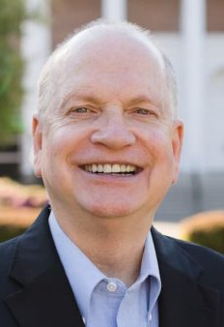
Dr. R. Scott Pace & Dr. Daniel L. Akin We need to learn how to say the right thing, in the right way, at the right time, and to the right person

Slide 9
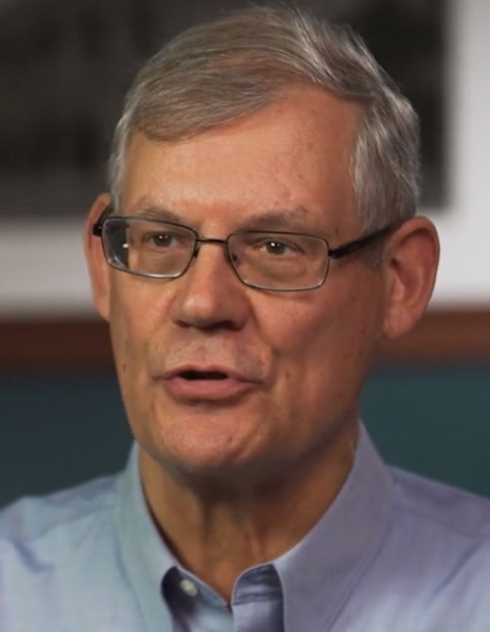
Dr. Douglas J. Moo Most interpreters agree that the body of the letter to Philemon begins at v. 8

Slide 10
Dr. R. Scott Pace & Dr. Daniel L. Akin Paul figuratively walks up to Philemon, gives him a big hug, and puts his arm around him.

Slide 11
Philemon, week 5 (pages 37-41)

Slide 12
Greek punctuation (page 13) Taken from p. 13 of Mounce’s Basics of Biblical Greek
Character | Looks like | Greek meaning
θεός, | comma | comma
θεός. | period | period
θεός· | period above | semicolon
θεός; | semicolon | question mark

Slide 13
Philemon, week 5 (pages 37-41)

Slide 14
Acts 4:13
When they observed the boldness of Peter and John and realized that they were uneducated and untrained men, they were amazed and recognized that they had been with Jesus.

Slide 15
Acts 28:30–31
Paul stayed two whole years in his own rented house. And he welcomed all who visited him, proclaiming the kingdom of God and teaching about the Lord Jesus Christ with all boldness and without hindrance.

Slide 16
Hebrews 4:16
Therefore, let us approach the throne of grace with boldness, so that we may receive mercy and find grace to help us in time of need.

Slide 17
BDAG on epitasso (ep-eh-TOSS-oh) to command with authority order, command

Slide 18
Excursus: Apostolic Authority
Matthew 10 (commissioning the 12)
40: The one who welcomes you welcomes me, and the one who welcomes me welcomes him who sent me.

Slide 19
Excursus: Apostolic Authority
John 17 (Jesus’ high priestly prayer)
20: I pray not only for these, but also for those who believe in me through their word.

Slide 20
Excursus: Apostolic Authority
Acts 2 (description of the early church)
42: They devoted themselves to the apostles’ teaching, to the fellowship, to the breaking of bread, and to prayer.

Slide 21
Excursus: Apostolic Authority
Ephesians 2 (unity in Christ)
19-20: So, then, you are no longer foreigners and strangers, but fellow citizens with the saints, and members of God’s household, built on the foundation of the apostles and prophets, with Christ Jesus himself as the cornerstone.

Slide 22
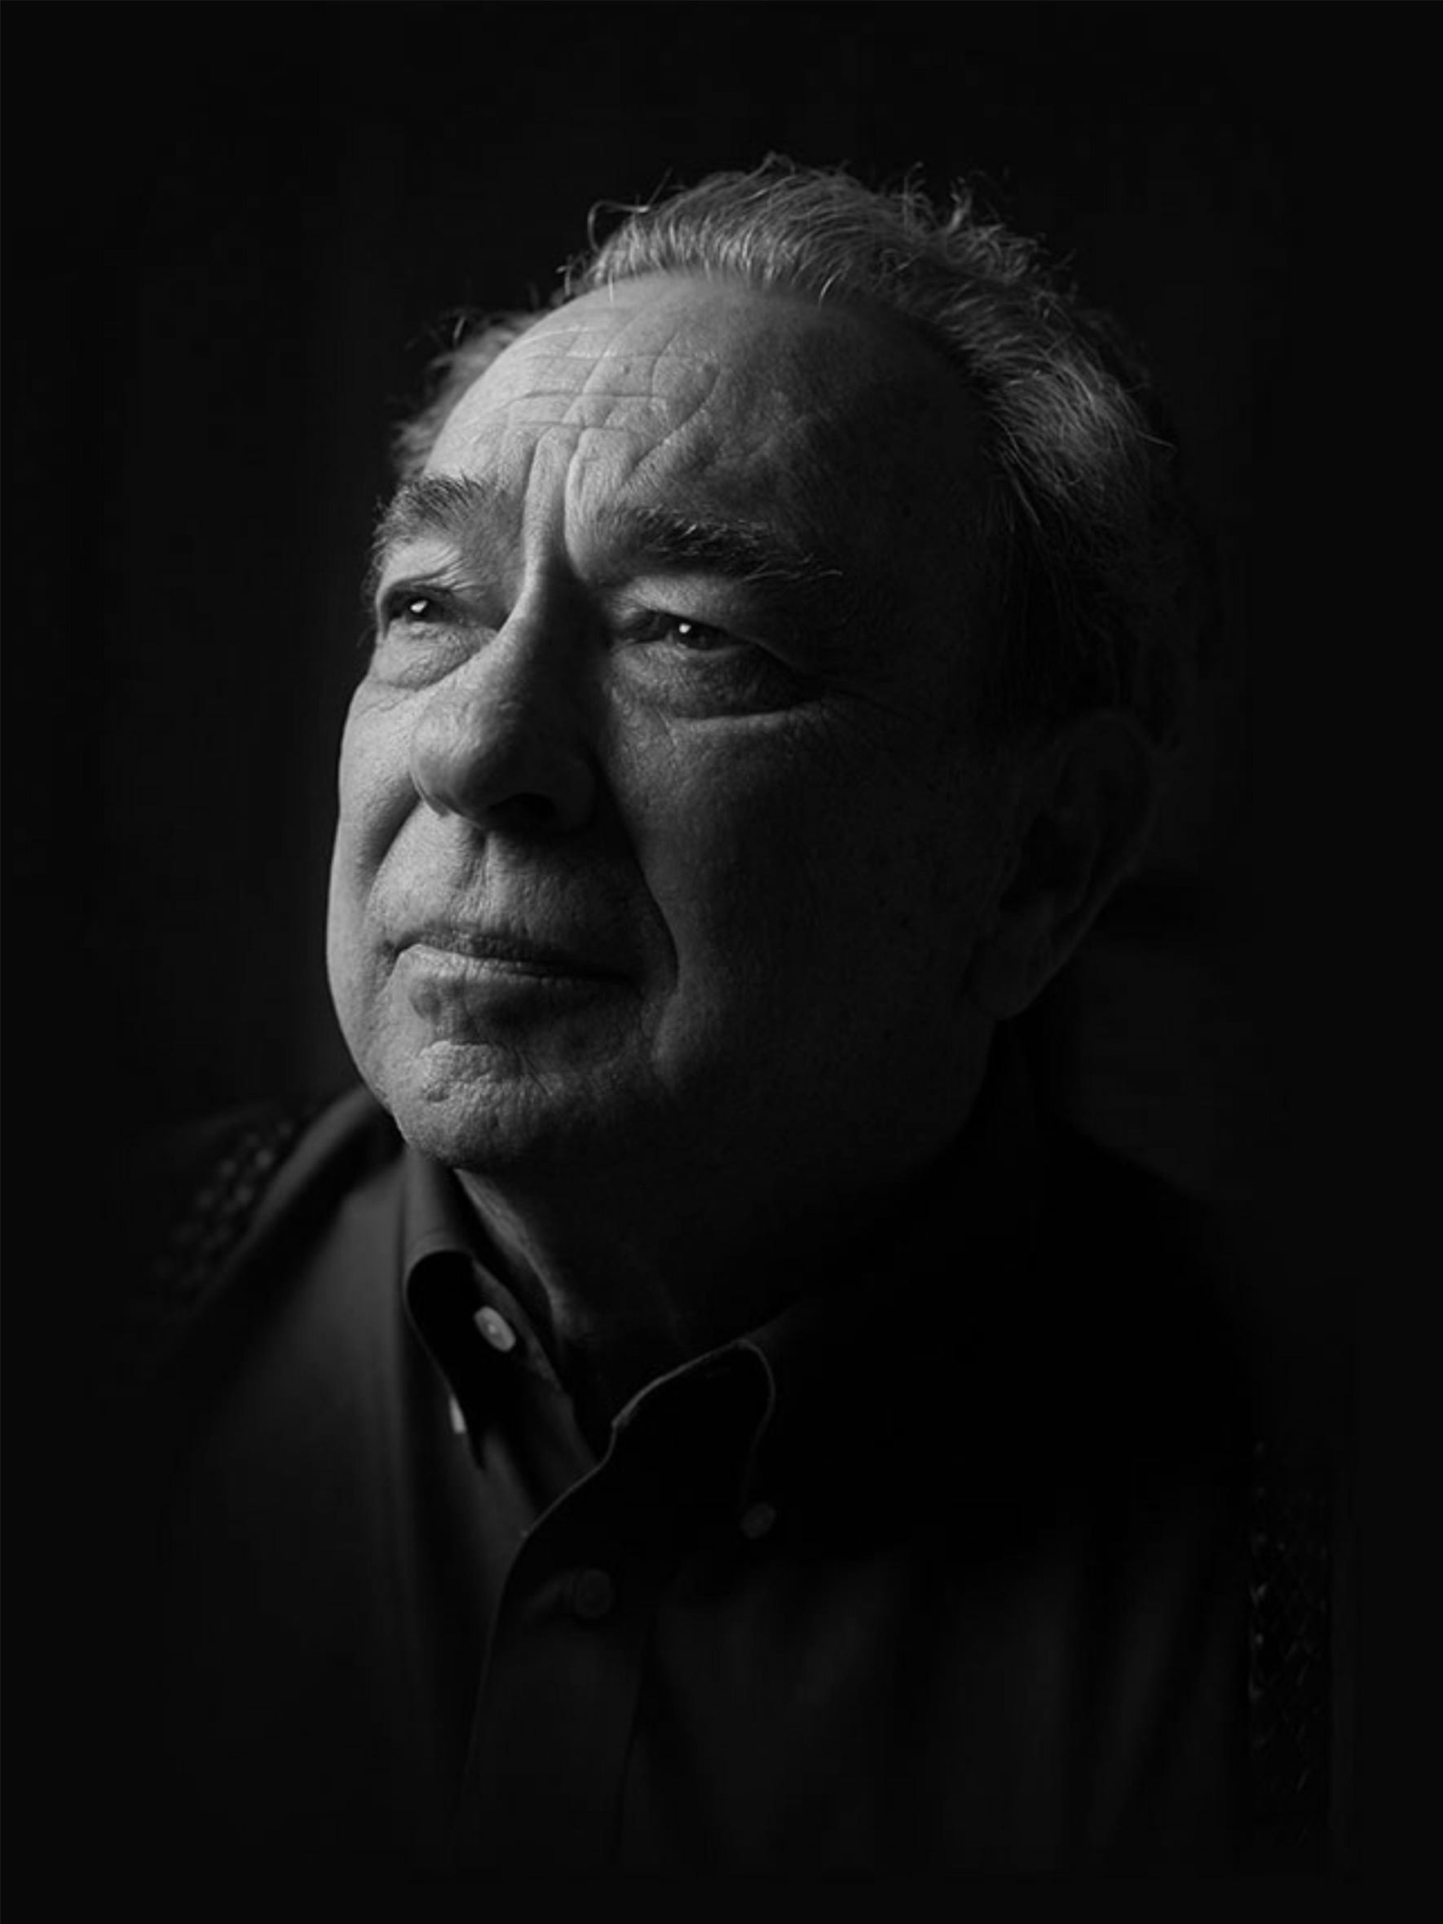
Dr. R. C. Sproul (from Ligonier.org) The apostles were granted special authority to speak for Jesus…. they had the right to command Christians to act in certain ways.

Slide 23
Dr. R. C. Sproul (from Ligonier.org) If we reject the authority of the Apostles, we reject the authority of Christ. And if we reject the authority of Christ, we reject the authority of God Himself.

Slide 24
Philemon, week 5 (pages 37-41)

Slide 25
BDAG on parakaleo (parr-ah-kah-LAY-oh) to reach a point of connection, with a focus on what is appropriate it is proper, fitting

Slide 26
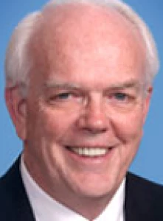
Dr. Richard Melick [“What is right”] speaks to what is proper because of the Christian order of things

Slide 27
Philemon, week 5 (pages 37-41)

Slide 28
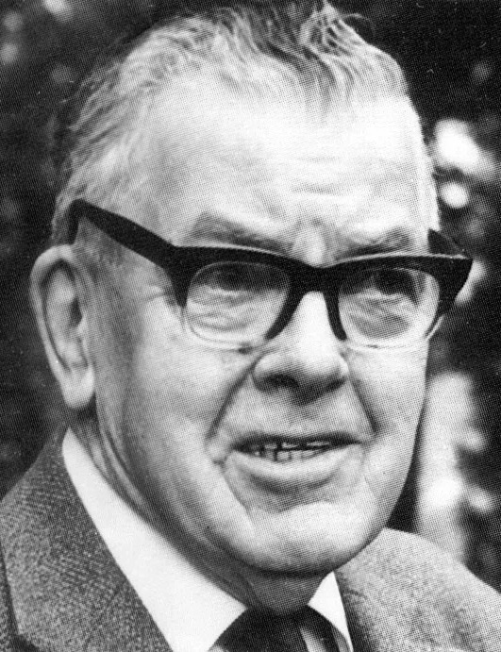
F. F. Bruce Orders are liable to be resented, from whomsoever they come, but an appeal from a friend is difficult to resist

Slide 29
Inspired by Moo
Paul
Jesus
Onesimus
Philemon

Slide 30
Dr. R. Scott Pace & Dr. Daniel L. Akin The love they share with each other because of Christ is the basis on which he will encourage Philemon to do the right thing.

Slide 31
Dr. Douglas J. Moo Our relationships to one another in Christ create expectations and impose obligations that cannot be ignored and that often go far beyond what any “law” might impose

Slide 32
Prayer time
Write down your prayer requests (on the Weekly Update or in the comments
Lean in, engage, and pray for someone not with you
Be out of this room by 9:50
Go worship

Slide 33
Philemon: week X (pages X–XX)

Slide 34
Preparing for Philemon 1:1–14 (page 16)
Pray with others Hear with others Think with others Study with others In class, as tables Share with others Invite others After class
In class, as a class

Slide 35
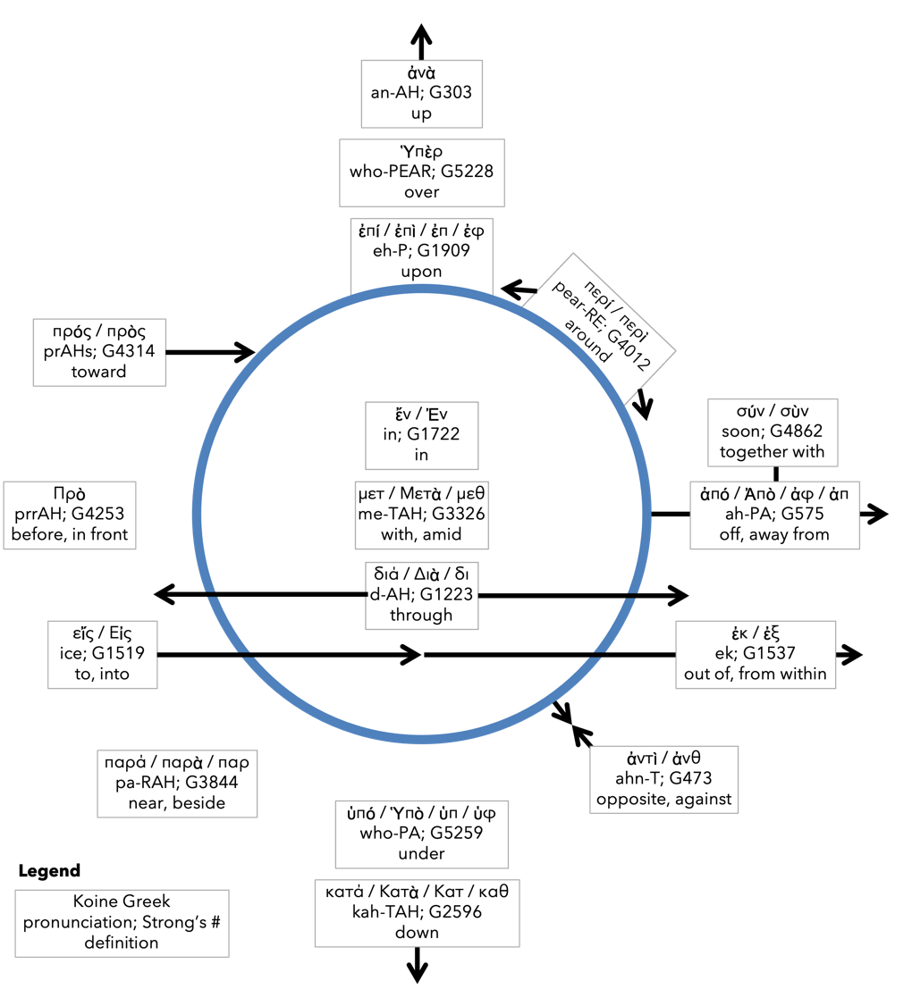
Preposition circle (page 11)

Slide 36
BDAG on morphe (mor-FAY) definition

Slide 37
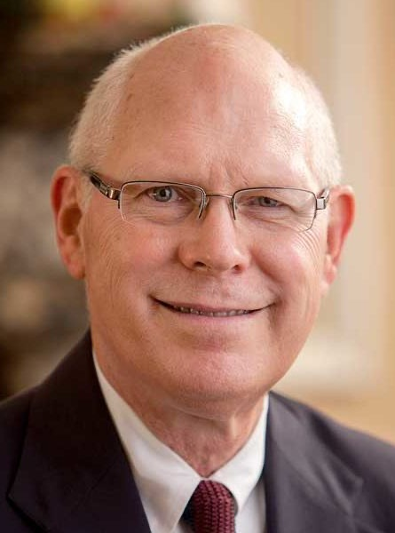
Dr. Gregory K. Beale Quote

Slide 38
F. F. Bruce Quote

Slide 39
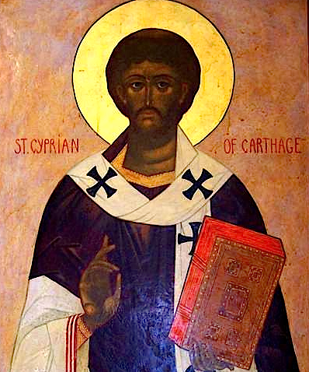
Cyprian Quote

Slide 40
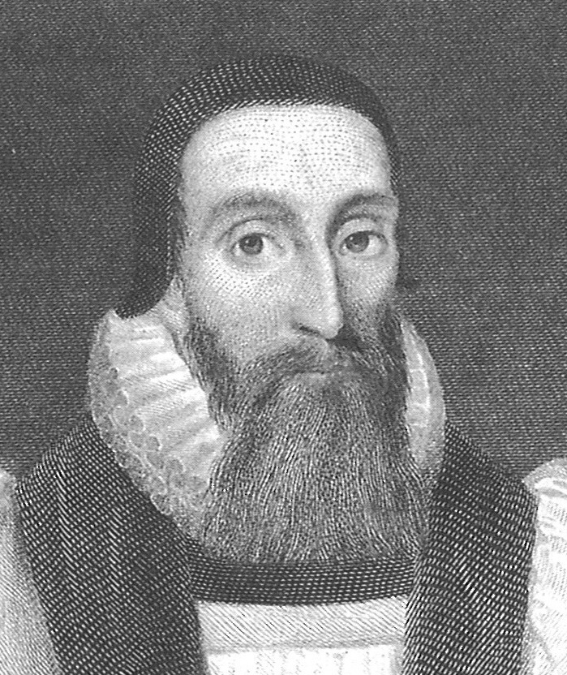
Dr. John Davenant Quote

Slide 41
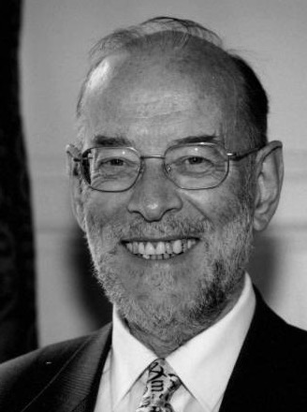
Dr. James D. G. Dunn Quote

Slide 42
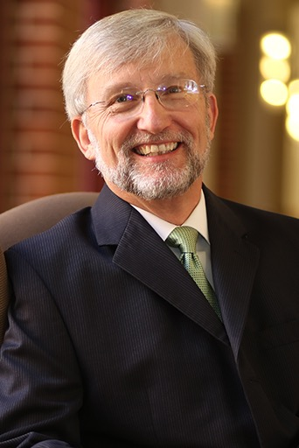
Dr. David Garland Quote

Slide 43
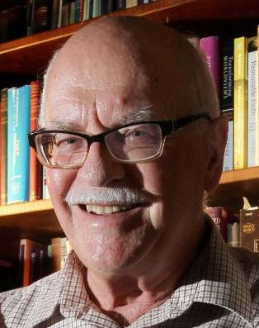
Dr. Murray J. Harris Quote

Slide 44
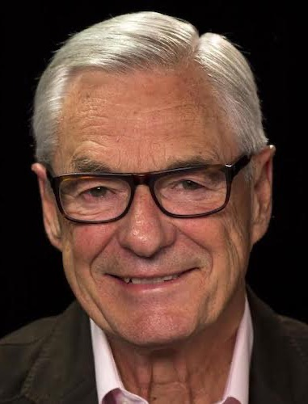
Dr. R. Kent Hughes Quote

Slide 45
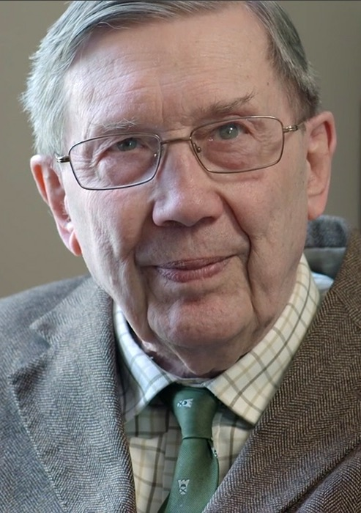
R. C. Lucas Quote

Slide 46
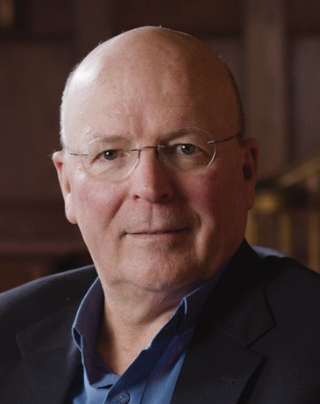
Dr. Scot McKnight Quote

Slide 47
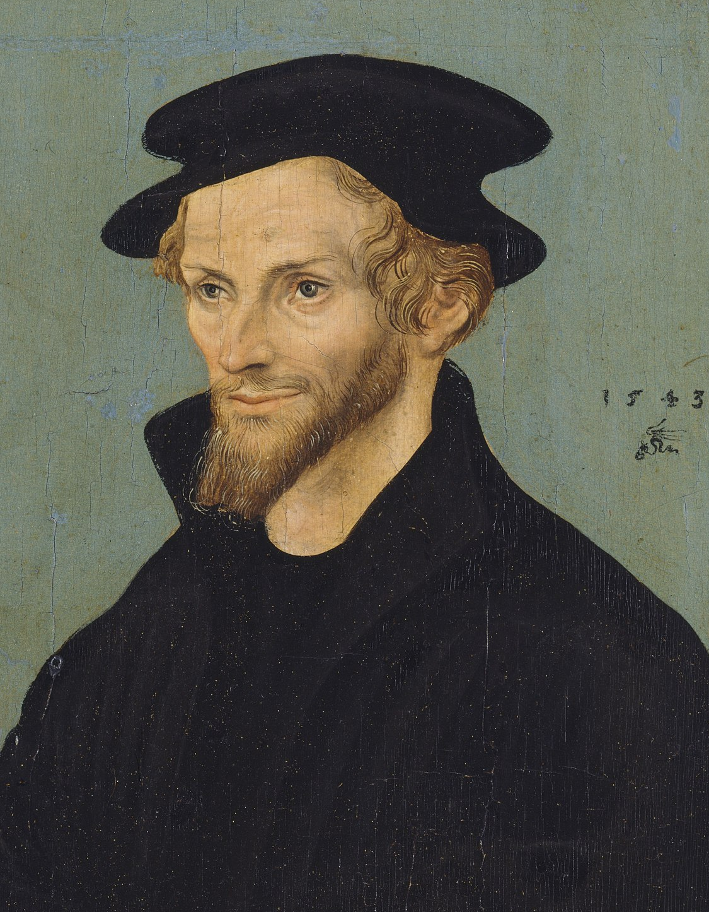
Philip Melanchthon Quote

Slide 48
Dr. Richard Melick Quote

Slide 49
Dr. Douglas J. Moo Quote

Slide 50
Dr. R. Scott Pace & Dr. Daniel L. Akin Quote

Slide 51
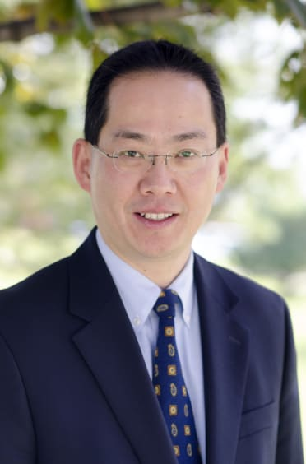
Dr. David W. Pao Quote

Slide 52
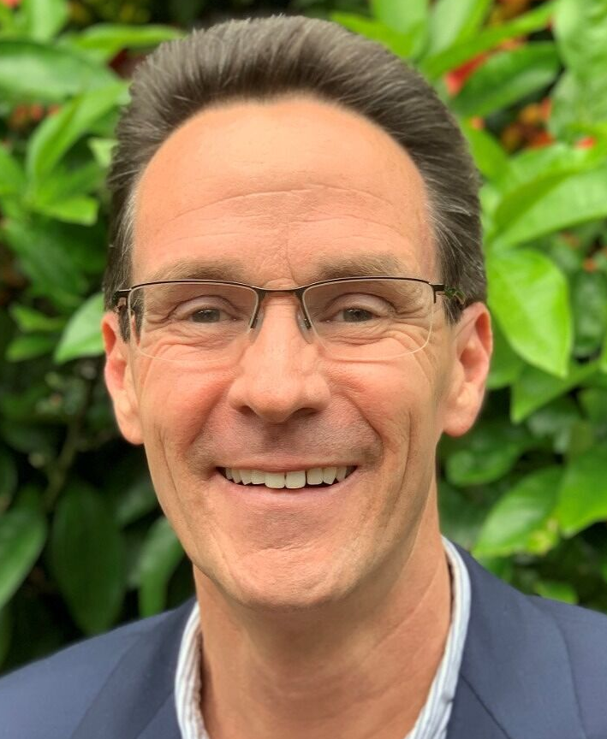
Dr. Alan Thompson Quote

Slide 53
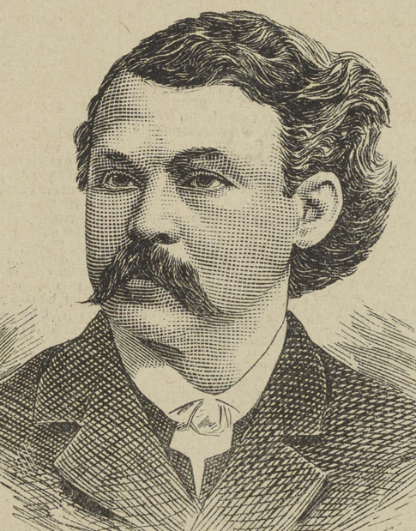
Dr. Marvin Vincent Quote

Slide 54
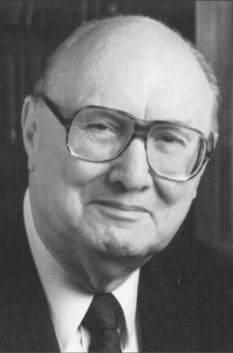
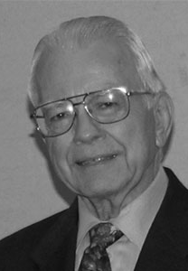
Dr. John F. Walvoord & Dr. Roy B. Zuck Quote

Slide 55
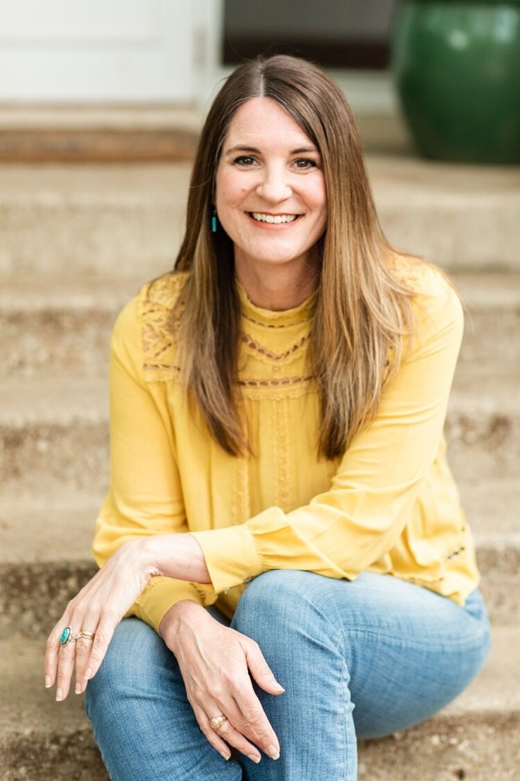
Jen Wilkin Quote

Slide 56
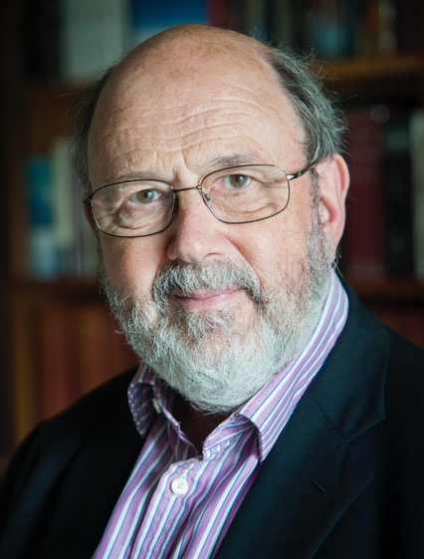
Dr. N. T. Wright Quote

